Slide 1
Seniors and Social Isolation
Anna Maria Izquierdo-Porrera MD PhD

Slide 2
Agenda
What does social isolation mean?
Why does social isolation happen in old age?
What are the consequences of social isolation?
How do we improve social isolation?

Slide 3
What does social isolation?
Social isolation can lead to loneliness in some people, while others can feel lonely without being socially isolated.
Social isolation
Loneliness
Social isolation is a lack of social connections.
Loneliness is the feeling of being alone, regardless of the amount of social contact.

Slide 4
What is the extent of the problem?

Slide 5
Who is at risk for Social Isolation?
Vulnerable older adults
Immigrants
LGBT populations
Minorities
Victims of elder abuse

Slide 6
Old age and social isolation
getting older or weaker,
no longer being the hub of their family,
leaving the workplace,
the deaths of spouses and friends,
disability or illness.

Slide 7
How culture can influence isolation
Cultural meanings shape the experience of loneliness in that they create expectations of the nature and the extent of closeness in relationships as well as social connectedness.
Conversely, the extent and nature of loneliness in a culture may be described as a property of that very culture.
Accordingly, a culture of loneliness is found in both individualist and communal cultures, but of different kinds.
Cultural loneliness: whereby someone is lonely while being in a foreign culture that leaves one feeling not understood and not able to reciprocate understanding about cultural meanings.

Slide 8
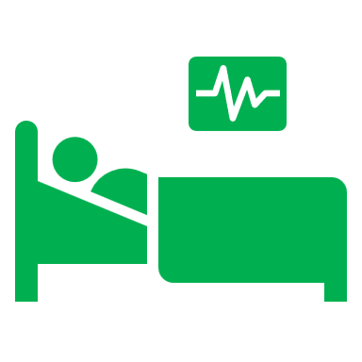
What are the consequences of social isolation?
Social isolation significantly increased a person’s risk of premature death from all causes, a risk that may rival those of smoking, obesity, and physical inactivity.
Social isolation was associated with about a 50% increased risk of dementia.
Poor social relationships (characterized by social isolation or loneliness) was associated with a 29% increased risk of heart disease and a 32% increased risk of stroke.
Loneliness was associated with higher rates of depression, anxiety, and suicide.
Loneliness among heart failure patients was associated with a nearly 4 times increased risk of death, 68% increased risk of hospitalization, and 57% increased risk of emergency department visits.

Slide 9
Cost of social isolation
$6.7 Billion
In additional Medicare spending

Slide 10
How to reduce social isolation in seniors
Individual
Community
Social skills training,
Community and support groups,
Befriending,
Cognitive behavioural therapy.
Creating more age-friendly communities
improving access to transportation
Information and communication technologies

Slide 11
References
Loneliness and Social Isolation—Tips for Staying Connected. (n.d.). National Institute on Aging. Retrieved March 17, 2023, from https://www.nia.nih.gov/health/loneliness-and-social-isolation-tips-staying-connected
Loneliness in older people. (2021, February 3). Nhs.Uk. https://www.nhs.uk/mental-health/feelings-symptoms-behaviours/feelings-and-symptoms/loneliness-in-older-people/
Loneliness and Social Isolation Linked to Serious Health Conditions https://www.cdc.gov/aging/publications/features/lonely-older-adults.html
Social isolation and loneliness among older people: Advocacy brief. (n.d.). Retrieved March 17, 2023, from https://www.who.int/publications-detail-redirect/9789240030749
van Staden, W., & Coetzee, K. (2010). Conceptual relations between loneliness and culture. . Curr Opin Psychiatry, 23(6), 524–529.

